Slide 1
“EVANGELISM” THE FORGOTTEN MISSION Matthew 28:18-20
HOW TO SEE IT , HOW TO REVIVE IT, HOW TO DO IT AGAIN

Slide 2
“EVANGELISM” THE FORGOTTEN MISSION Matthew 28:18-20
PART 1
HOW TO SEE IT

Slide 3
IT IS ALWAYS HARVEST TIME FOR SAINTS
John 4:35-37 (ESV) ³⁵ Do you not say, ‘There are yet four months, then comes the harvest’? Look, I tell you, lift up your eyes, and see that the fields are white for harvest. ³⁶ Already the one who reaps is receiving wages and gathering fruit for eternal life, so that sower and reaper may rejoice together. ³⁷ For here the saying holds true, ‘One sows and another reaps.’

Slide 4
THE LABORERS ARE FEWER THAN THEY NEED TO BE – THERE ARE MANY IN NEED OF SALVATION
Matthew 9:37-38 (ESV) ³⁷ Then he said to his disciples, “The harvest is plentiful, but the laborers are few; ³⁸ therefore pray earnestly to the Lord of the harvest to send out laborers into his harvest.”

Slide 5
"Evangelism: A Forgotten Mission of the Church"
Matthew 28:18-20 (ESV) ¹⁸ And Jesus came and said to them, “All authority in heaven and on earth has been given to me. ¹⁹ Go therefore and make disciples of all nations, baptizing them in the name of the Father and of the Son and of the Holy Spirit, ²⁰ teaching them to observe all that I have commanded you. And behold, I am with you always, to the end of the age.”
Christ himself is the source of authority for our commission to save souls. His spirit reveals the kind of interest we must have:

Slide 6
"Evangelism: A Forgotten Mission of the Church"
Luke 19:9-10 And Jesus said unto him, This day is salvation come to this house, for so much as he also is a son of Abraham. For the Son of man is come to seek and to save that which was lost.
Christ came to seek and saved the lost. How can we be followers of him if we are not focusing on saving the lost?
Salvation has come to the world because all men are descendants of Adam and will be Abraham’s seed upon obedience to the Gospel. Gal 3:14,26-29
Gal 3:26-29 And if you are Christ’s, then you are Abraham’s seed, and heirs according to the promise. Gal 4:28 Now you brethren, like Isaac, are children of promise.

Slide 7
FIRST: FORMS OF THE COMMAND
MATTHEW 28:18-20 Focus is on the mission of the Disciples [Go ye]
MARK 16:15-16 Focus is on the faith response of the prospect [believe and is baptized]
LUKE 24:45-49 Focus is on the process and primary emphasis [preach/teach forgiveness]
John 20:19-23 Focus is on the results [whosoever sins ye remit they are remitted]
Acts 1:6-8 Focus is on the multiple mix of humanity [ Judea, Samaria, all parts of earth]
We must not allow the ethnic makeup of a community, or city dictate the object of our efforts.

Slide 8
SECOND: WHAT DID EVANGELISM LOOK LIKE?
What did the original evangelistic mission look like? Studying the book of Acts can help.
1) It was a response to the authoritative command of Christ. True soul-winners are conforming to a directive from the Lord and thus are influenced by HIS sense of urgency. Scriptures repeatedly say of Jesus: Afterwards; Immediately, Straightway.
2) It was a lifestyle in appearance. Circumstances had taken place that did not allow for selective evangelism and personal choice of timing. Acts 8:3-5; 11:19-21. Their faith had to go wherever they went and share what they had believed; and practice what they had been taught.
3) It was mission oriented and often called for special attention, effort and sacrifice.

Slide 9
SECOND: WHAT DID EVANGELISM LOOK LIKE?
What did the original evangelistic mission look like? Studying the book of Acts can help.
4) It was leadership led; minister involvement; membership engagement. Acts 10 Peter took brethren with him but he did the teaching. Evangelism is not just for the pew, the lay members; the un-anointed.
5) It had a discipleship objective Matt 28:20; 1 Thessalonians 1:1-10. The goal is threefold: first to save some; second to disciple the saved; third to appoint those discipled to begin the process with their prospects. If there is no sharing of the anointing, there is no broadening of the workforce and the mission soon dies and only continues in symbolism.

Slide 10
SECOND: WHAT DID EVANGELISM LOOK LIKE?
What did the original evangelistic mission look like? Studying the book of Acts can help.
6) It was focused on a view to eternity Tit 1:2 Soulwinners are bringing men into the hope of an eternity with Christ – it is the hope of eternal life which is available to all. Yet not only is the vision shared with all; but the work is divided among all.
7)It was Holy Spirit directed; Christ centered; truth based – and soul conscious. The Holy Spirit does not lead us to be content with the number of saved souls.
8) It was prospect focused: 1 Cor 9:16-23. True evangelism sees prospects everywhere. Evangelism goes after the prospects and seeks to introduce them to Christ.

Slide 11
THIRD: WHY WAS EVANGELISM FORGOTTEN?
WHY: One way may have been that the focus shifted from worship and soul-winning to personal pleasure and religious stage performances; to a religious style of honky-tonk – on Sunday rather than Saturday night.
REASON: It may have shifted to criticism, embarrassing, condemning, belittling, ignoring, and selectivity: seeking out a certain class or status of people who soon lost interest in the church because its focus turned out to be self-serving.
REASON: Focusing on getting people in the congregation rather than saving souls
REASON: Forgotten because the income is sufficient and the sanctuary is comfortable.
REASON: Seeking prospects like themselves in thought, action, interests, ect.
REASON: Prejudging others regarding the likelihood of conversion Example: Campaign in Springhill, LA
REASON: Weeding out prospects by scripted elimination questions and discussion. Example: Jamaica mission; Some evangelism plans that use their personal views to exclude those wanting to be saved. Marriage issues; social issues; political views.

Slide 12
THIRD: WHY WAS EVANGELISM FORGOTTEN?
REASON: Syncretism, worldliness, and self-centeredness along with the universalist view of salvation reduced the commitment and urgency of evangelism because men became convinced that:
Christ died for everyone and therefore are all saved so.
Then there was a development of the doctrine of divine selectivity which filtered into the church -
Then a spirit of complacency crept into the church fueled by the idea that the end of the world was far into the future so there would be time to focus on soulwinning.
Add to that the idea that soul-winning was the work of the evangelist almost exclusively and members were to simply enjoy their salvation and live righteous lives.

Slide 13
THIRD: WHY WAS EVANGELISM FORGOTTEN? The “Isms”
REASON: Internal strife and disagreements leading to debates and combat zones among brethren who transition to the internal fight mode than the external conquer mode.
Evangelism is an external conquer mode seeking to conquer the territory overseen by Satan and deliver the souls to Christ thus creating larger citizenship of the Kingdom of God.
Our mission is the expansion of the kingdom, not cutting it up in small sectors and blocking off the borders.
Brotherhood issues have refocused our attention too often and left us paralyzed for evangelism. The church does not belong to us, it belongs to Christ. The mission is not ours, it is His. The people do not belong to us, they belong to Him.

Slide 14
FOURTH: WHAT METHOD OR APPROACH DID THEY USE?
IDENTITY WITH HUMANITY: Paul became all things to all men 1 Cor 9:19-23. Soul-winners do not see themselves as superior to others.
Soulwinning can take place in:
group Bible classes designed to convert
Sermons designed to convert
Question and response methods - ex Muscle and a Shovel
One on one
Family Bible studies
Text discussions
Personal letters
Sheet lessons; power point; filmstrips; video’s;
Share a ride
Visitations

Slide 15
“EVANGELISM” THE FORGOTTEN MISSION Matthew 28:18-20
PART 2
HOW TO REVIVE IT

Slide 16
How WE can become a stronger EVANGELISTIC congregation.
1. REDISCOVER THE EXCITEMENT, JOY AND REJOICING WITH THE CONVERTED AND THE BELIEVERS WHO BROUGHT THEM TO CHRIST..
Lk 10:17 The seventy-two returned with joy, saying, Lord, even the demons are subject to us in your name.
Acts 8:8 There was much joy in that city
Acts 8:39 He went on his way rejoicing. Does Phillip rejoice also?
Acts 16:34 The Jailor rejoiced with his house. Does Paul and Silas rejoice also?
SHOULD WE ASSUME THAT ONLY THE CONVERTS REJOICED? DID NOT ANY OF THE SAINTS REJOICE?
MY BROTHER QUESTIONED THE URGENCY AND INTENSITY OF TRYING TO BRING SOMEONE TO CHRIST UNTIL HE SAW A BAPTISM TAKE PLACE: HIS HEART CHANGED.
My interpreter in Haiti following the massive earthquake.
Everyone needs to see the heart of a true convert when he is saved and realizes that he has the hope of glory.

Slide 17
How WE can become a stronger EVANGELISTIC congregation.
1. Write Evangelism into the church mission
2. Tie everything the church plans to the mission of the church
3. Work the Gospel meetings and workshops with an evangelistic urgency. Advertise in the community for every event and include something in the event that helps people see a need for the Lord, not just enjoy the environment.
4. Train the whole church and make the whole church accountable. Begin with the Ministers, elders, deacons, department heads, education department, office staff, grounds men. Create missions and goals and plan a celebration for meeting the mission.
REMEMBER: We are all God has in this world to teach the lost and convert them to Christ. Eph 3:8-10
[what we did – campaign]
We celebrate every 5th Sunday with the new members of our congregation. We have a meal and time to meet them.
We have an aftercare team charged with staying close to them
We created an Evangelism Committee.
IDENTIFY EVANGELISTIC TRAINING MATERIAL
DEVELOP YOUR OWN LESSONS SPECIFICALLY FOR EVANGELISM

Slide 18
DON’T DO THIS
SOFT CORE EVANGELISTIC TACTICS
Just talking and sharing – having a conversation.
Misleading about your motives. I don’t want to convert you.
Self-discovery approach: just letting people discover on their on. They will eventually figure it out.
HARD CORE EVANGELISTIC TACTICS
Trick methods
Manipulation
Focusing only on getting them in the water
Paying the numbers game

Slide 19
“EVANGELISM” THE FORGOTTEN MISSION Matthew 28:18-20
PART 3
HOW TO DO IT AGAIN

Slide 20
DO THIS
HELP THEM TO SEE THEIR NEED TO OBEY THE LORD. BE DELIBERATE AND INTENTIONAL
I write letters to the visitors asking them to meet with me.
I let them know I want to show them in the Scriptures how people in Scripture got saved.
Develop lessons to answer their concerns and share the discovery process allowing them to participate when appropriate.
HOLD GROUP BIBLE STUDIES WHEN APPROPRIATE
Ensure that the group is not loaded with people who are determined not to see or is set to destroy the class so others will not see it.
Answer questions with Scripture and offer to research questions that require more study.

Slide 21
JESUS SAID:
COME UNTO ME –
I WILL GIVE YOU REST
Matt 11:20-30

Slide 22
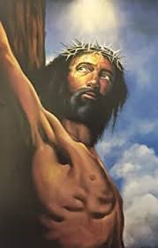
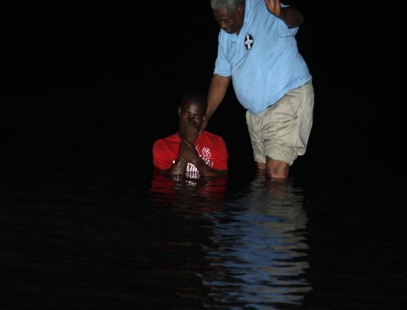
INTRODUCING THE CHURCH OF CHRIST
BRINGING HONEST HEARTS FROM BELIEF TO SALVATION IN CHRIST AND HIS CHURCH

Slide 23
Baptism is a Bible command
For Salvation
Matthew 28:19
Mark 16:16
Acts 2:38
Acts 8:35-39
Acts 10:46-48
Acts 22:16
I Peter 3:21

Slide 26
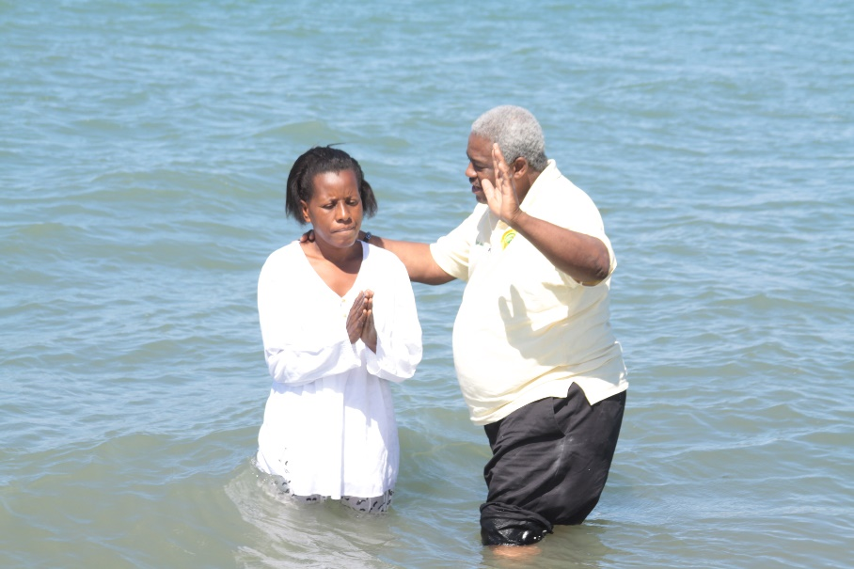
Resolving the Baptism Question

Slide 27
WHAT MAKES THE DIFFERENCE IN BAPTISM
1 CORINTHIANS 1:10-13; ACTS 19:1-5
Notes:
NOTE:
To change the image on this slide, select the picture and delete it. Then click the Pictures icon in the placeholder to insert your own image.

Slide 28
MEN MADE OVER FOR THE MASTER
LESSON FOR THE NEW CHRISTIAN

Slide 29
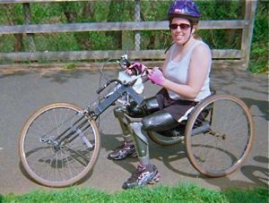
WE ARE FAMILIAR WITH THE CONCEPT OF MAKEOVER – WE SEE IT ALL AROUND US

Slide 30
“EVANGELISM” THE FORGOTTEN MISSION Matthew 28:18-20
ALWAYS PRAY FOR HARVEST

